Slide 1
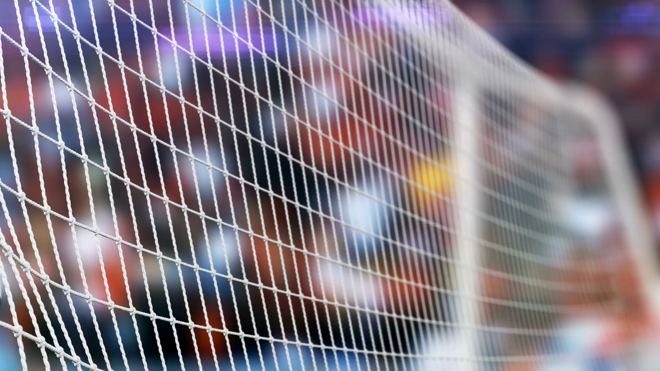
Using ML to predict EURO 2021 soccer championship.
Alexey Osipov.

Slide 2
EURO championship.
Qualified 24 teams.
Fixed draw.
Group games.
Play-off games.
Goal. Identify the probability to be a champion.

Slide 3
General scheme.
Team A vs Team B. What is the probability of s1-s2=s?
Group stage specifics.
Play off specifics.
MC method.

Slide 4
Dataset 1. Covariate data.
4 previous EUROs.
Economic factors.
Home factors.
Sportive factors.
Team factors.
Coach factors.

Slide 5
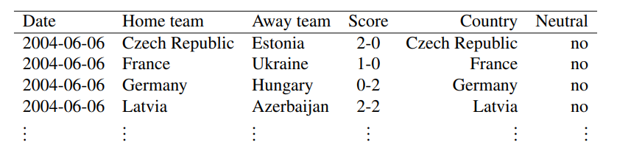
Dataset 2. Historic match results.
Last 8 years.
Various types of games.

Slide 6
Dataset 3. Bookmaker consensus.
19 bookmakers for 24 teams.
EURO 2021.
4 previous tournaments.

Slide 7
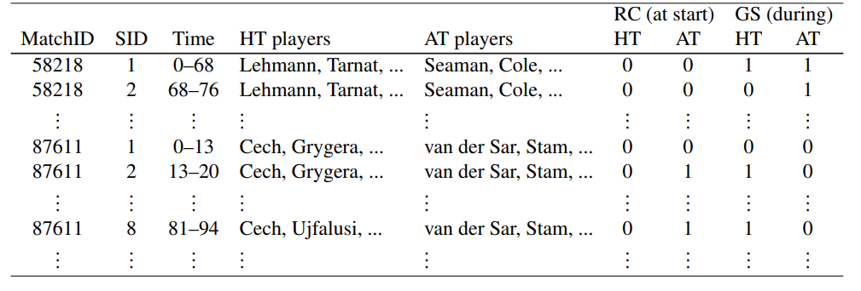
Dataset 4. +/- Player data.
Mean +/- rating of the squad.
Median +/- rating of the squad.
Average +/- rating of best 11 players.
Number of best 11 players that are not in squad, but could be.

Slide 8
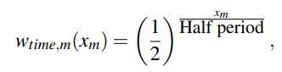
Current ability ranking model.

Slide 9
Bookmaker consensus model.
Gross prices => net prices.
Net prices => probabilities.
Averaging.

Slide 10
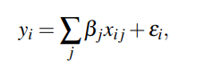
+/- Player model

Slide 11
Hybrid model.
Features are both dataset features and outputs of the other models.
Candidates:
Random forest (2 implementations).
Xgboost
Linear model (lasso regression).

Slide 12
CV & metrics.
CV by championships.
Multinomial likelihood.
Classification rate.
Rank probability score.

Slide 13
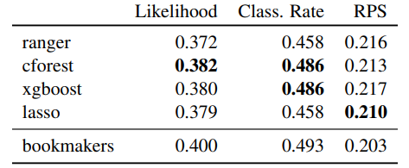
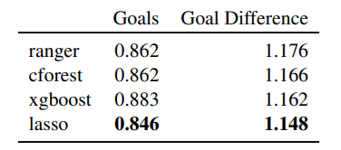
Results.

Slide 14
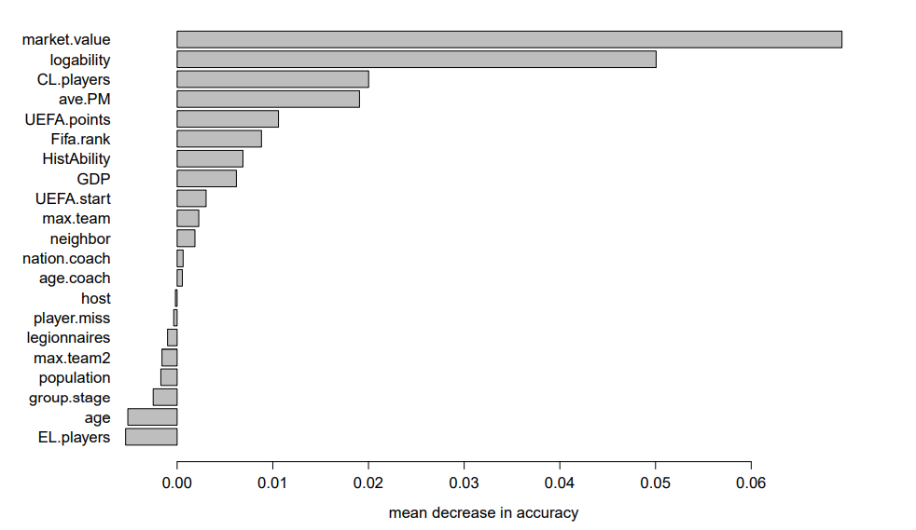
Applications.
Take all history.
Remove home factor.

Slide 15
Game model.
Their model: 2 dependent Poisson distributions, Skellam distribution.
Our model, 2008: lambda, mu, Markov model for goals.
Conceptually they should be the same.

